Slide 1
New Tactical Process for handling Subsequent Port Activation requests Email Template Design Specification V7
OTA facilitated a series of meetings over the period Sept-Nov’12, involving a small multilateral team of Stakeholders to develop the necessary plans and specs needed.
This Specification has been specifically developed by Dan Blankley (BSkyB) & Rob Deane (TalkTalk) on behalf of industry and has been signed off by the Stakeholders in the team.

Slide 2
Scenarios to Support
All Subsequent Port Activation Requests Involving all CP’s with the exception of BT SUP Imports
All Direct Port Request’s Between
Sky <-> Talk-Talk
Talk-Talk <->Virgin
Virgin <-> Sky
Single Requests (1 Per Sheet)
Multiple Requests (Many Per Sheet – Unlimited)

Slide 3
Activation Report
Field 1
Name: Telephone Number
Rules: Mandatory, Full Number Including Leading 0**, Numerical Only, No Spaces
Field 2
Name: Order Number
Rules: Non-Mandatory, 8 Character Alphanumeric*
Field 3
Name: Response Email Address
Rules: Non-Mandatory, Target for return of form, local@domain
Field 4
Name: GCP Name
Rules: Non-Mandatory, Alphanumeric
Field 5
Name: GCP CUPID
Rules: Non-Mandatory, Numerical Contained within GCUPID set, 3 digits
Field 6
Name: GCP Prefix
Rules: Non-Mandatory, Numerical, Leading 5 Obligatory.
Field 7
Name: Activation Status
Rules: Mandatory, Values [Requested, Completed RH, Completed LCP, Rejected, Pending]
*Discussion Point – This is a proposal. Can we agree this please
**Point to Note – When reading a CSV in excel it will tend to remove the leading 0

Slide 4
File Details
FileName
For A Batch Request
ActReq_[GCP NAME]_BATCH_[Date Generated YYMMDD]_[Batch ID].csv
For A Single Request
ActReq_[GCP NAME]_SINGLE_[Date Generated YYMMDD]_[CLI].csv
For Batch Requests the Batch Number is the Number of that batch sent from the GCP that day
Batch ID should be a unique identifier determined by the GCP that identifies the particular batch file.
Batch Requests with only 1 entry can use the Batch Request file name.
Single Requests cannot contain more than 1 entry
Single Requests Filename contains the CLI with the leading 0

Slide 5
Field Completion Rules
The inclusion of Non Mandatory Fields is to be agreed on a per CP basis.
Non Mandatory Fields should be in the CSV but left NULL to allow automated processing
The lowest amount of data allowable would be
[Telephone Number],,,,,,[Activation Status]

Slide 6
Additional Information
A file can contain a mix of RRH, PRO and SUP Activation Requests
A file can contain activation requests with a mixture of activation status in order to facilitate the SUP activation process
If Read in a text viewer the final field is not terminated by a comma but by a new line character
Every File has to contain the field name header as described within this slide deck

Slide 7
Example CSV Output
Filename For A Batch Request
ActReq_TalkTalk_BATCH_120913_001.csv
Filename for A Single Request
ActReq_VM_SINGLE_120927_020836253764.csv
Data
Telephone Number,Order Number,Response
Email Address,GCP Name,GCP CUPID,GCP Prefix,Activation Status
02073434857,TT937T20,robot@talktalkplc.com,TalkTalk,820,551234,Requested

Slide 8
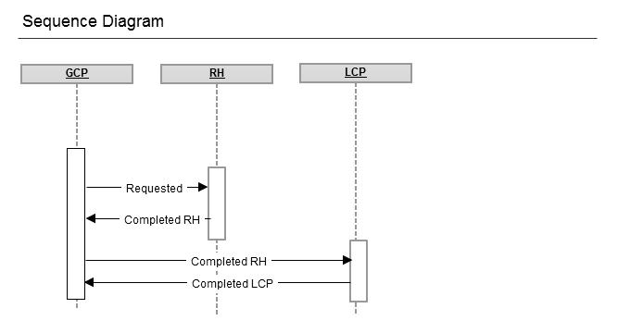
Happy Path SUP Activation

Slide 9
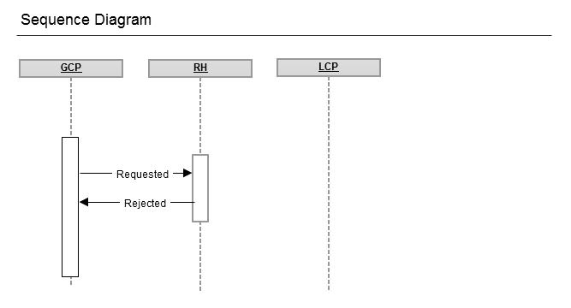
SUP Activation Rejection

Slide 10
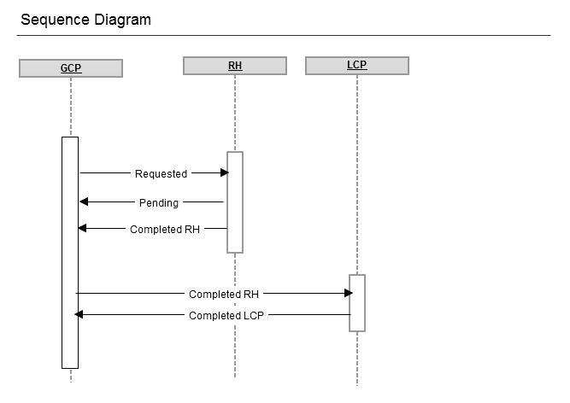
SUP Activation Pending

Slide 11
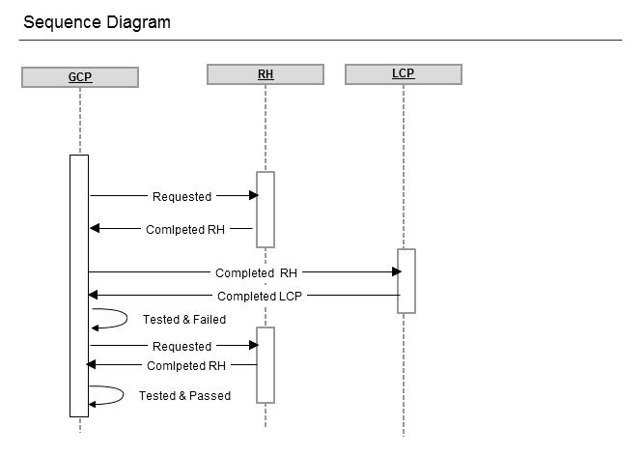
SUP Activation With Test Fail

Slide 12
Subsequent Port Activations
CSV template

